Slide 1
CS3020 Calculator Project
Jamie Wadge

Slide 2
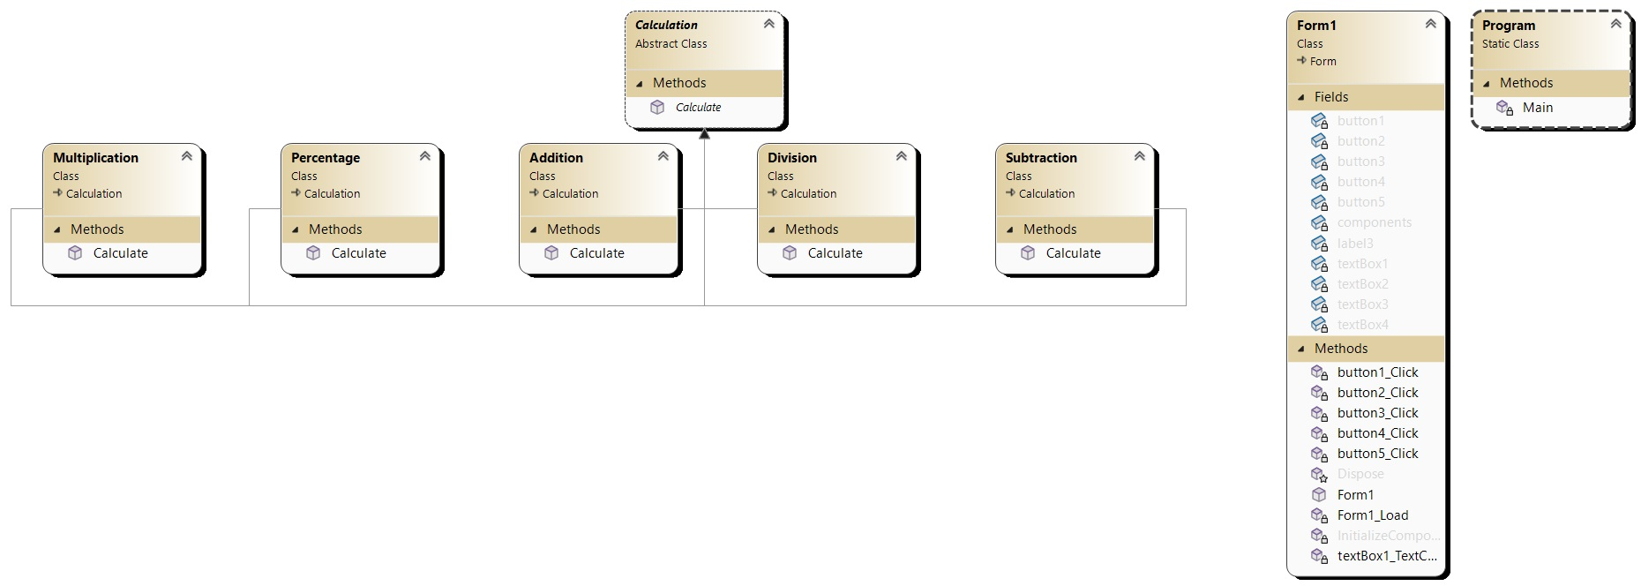

Slide 3
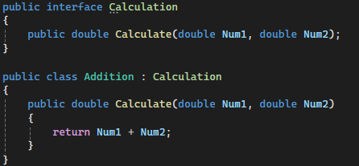
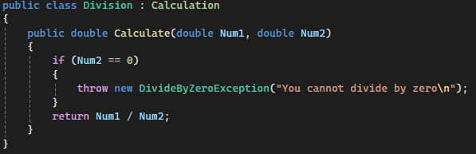
Multiple classes inheriting from Calculation
Each class performs the calculation for corresponding operation
Percent and division throw exception if second number is 0

Slide 4
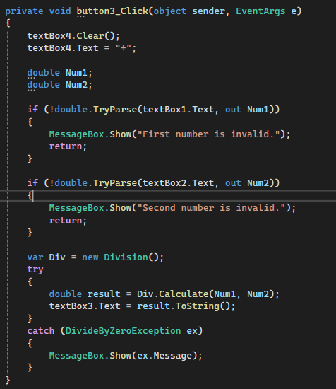
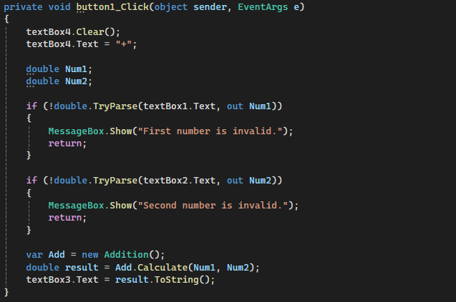
Button clicks check if input is valid
Do calculation using corresponding operation class
Display the results in textBox3
Percent and division try calculation and catch DivideByZeroException

Slide 5
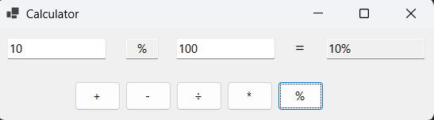
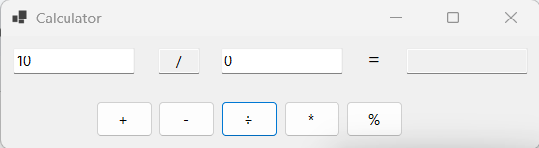
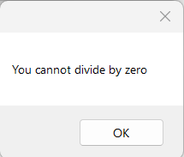
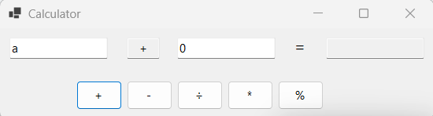
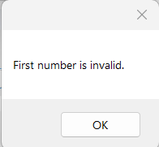
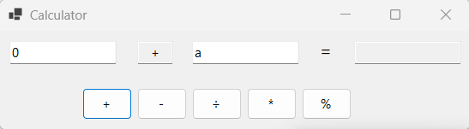
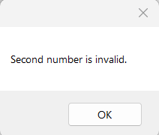
Numbers are entered in first and second text box
When any operation button is pressed the result is displayed in the last text box
Only works if a number is entered into both boxes

